Slide 1


Membership & Partnership Opportunities
www.granhub.co.uk | info@synergysolution.co.uk

Slide 2
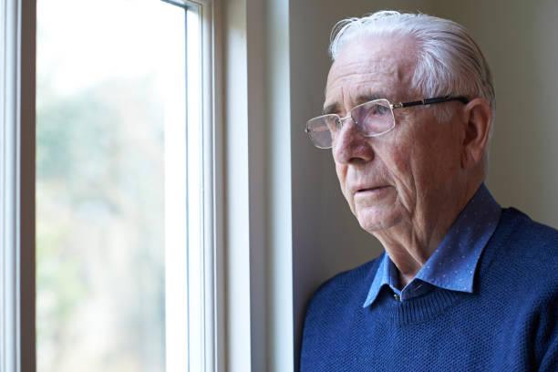
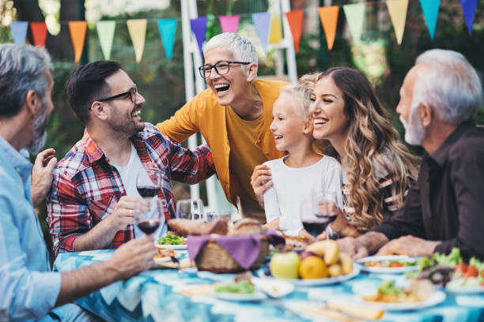
Why Matters
1 in 3 older people in the UK feel lonely often.
Families lack structured opportunities to connect across generations.
Grandparents play a vital role, yet often feel disconnected or unsupported.
Granhub’s Mission:
To create A world where generations are connected, valued, and thriving together with meaningful experiences, resources, and communities that bridge the gap between grandparents and grandchildren.
www.granhub.co.uk

Slide 3
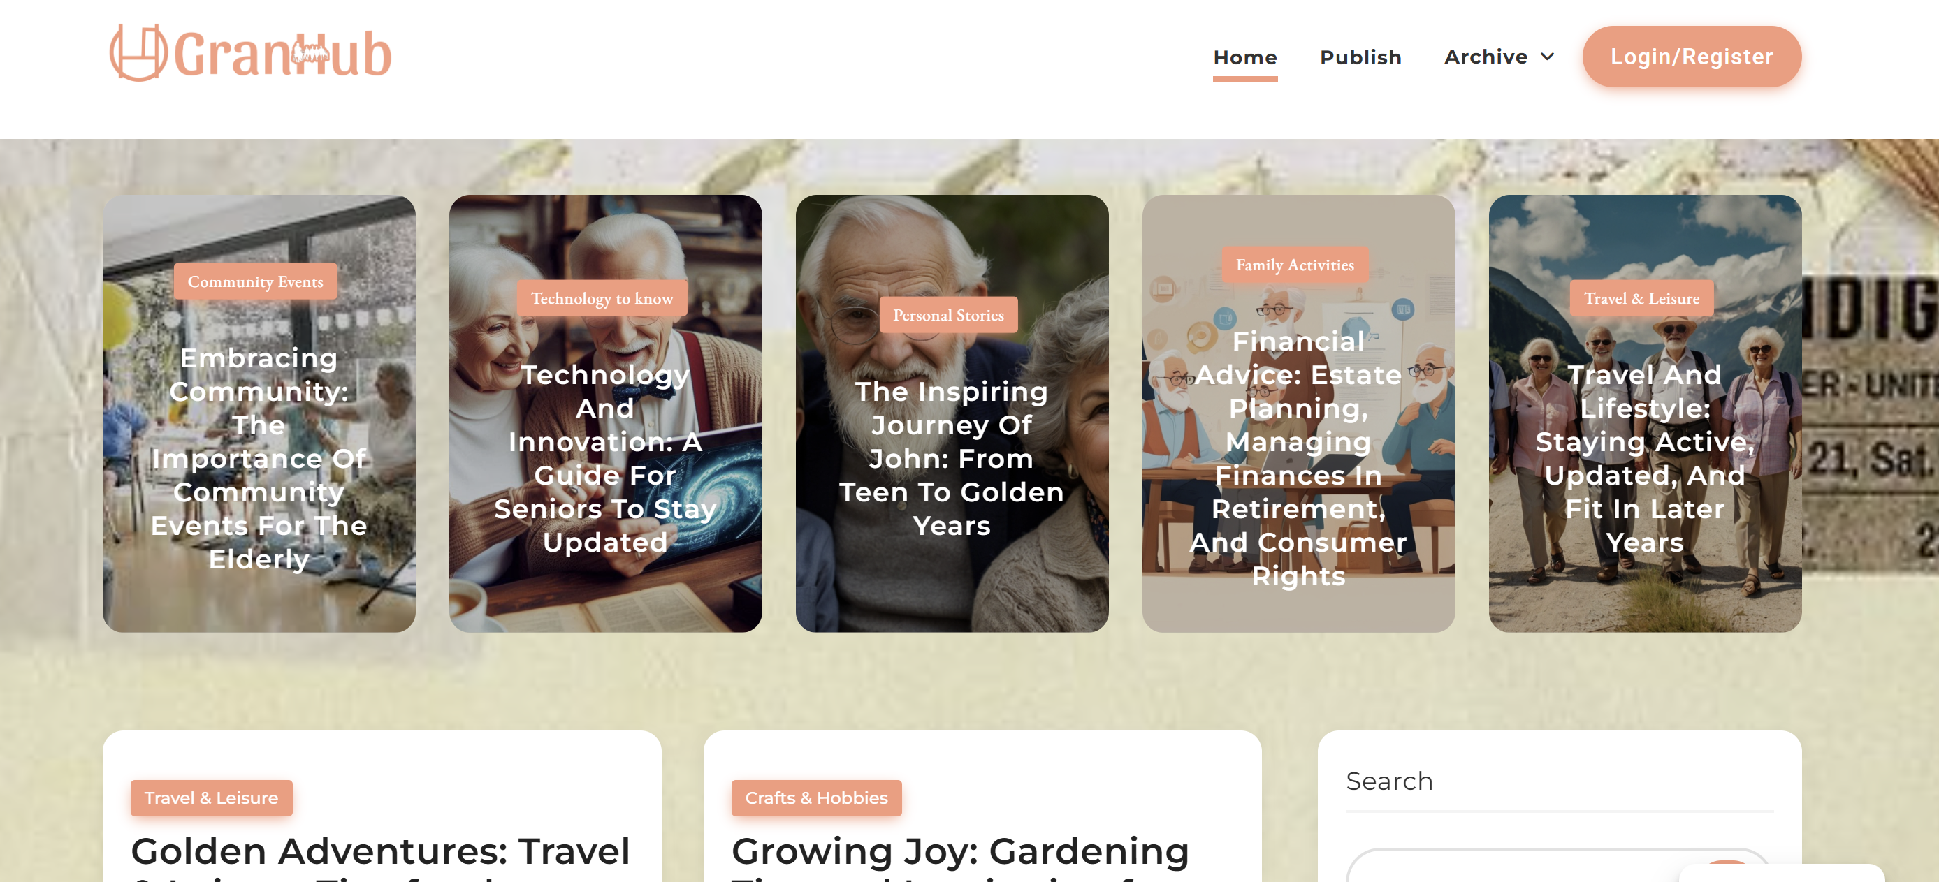
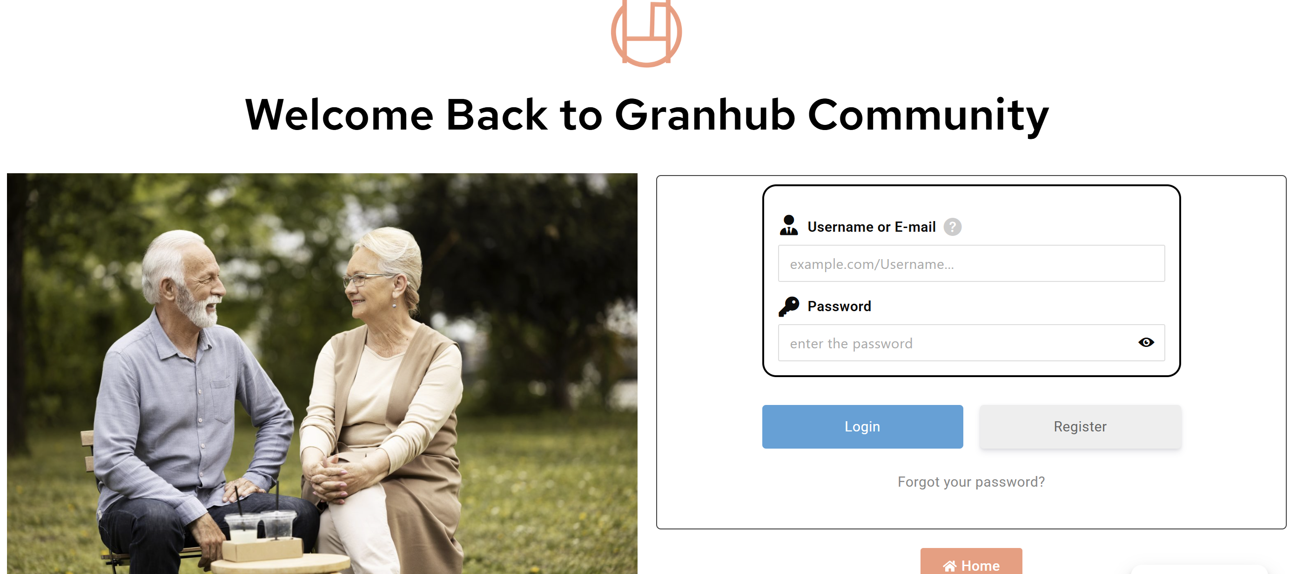
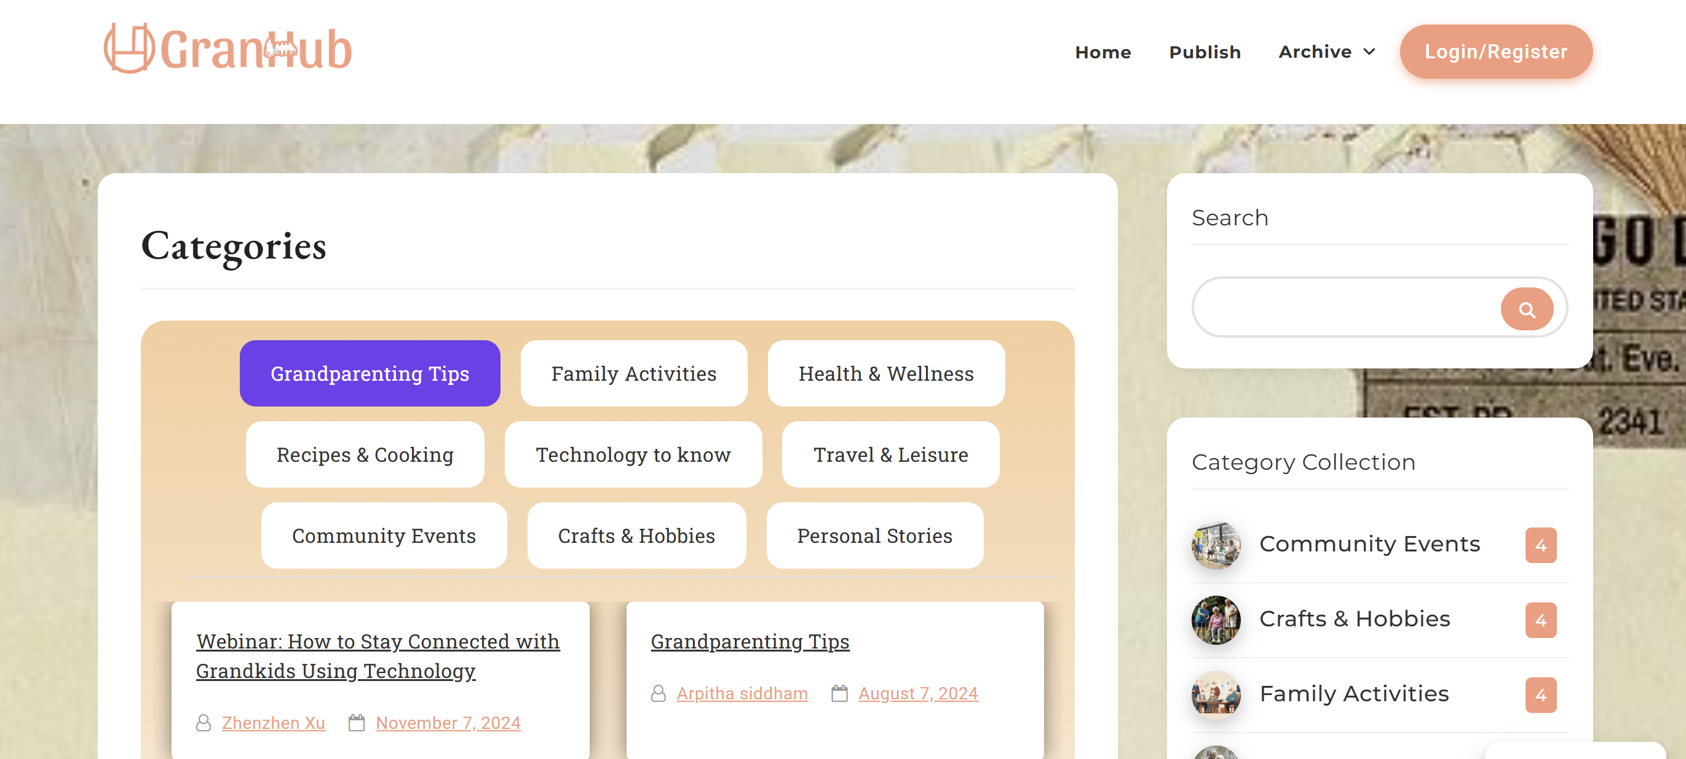
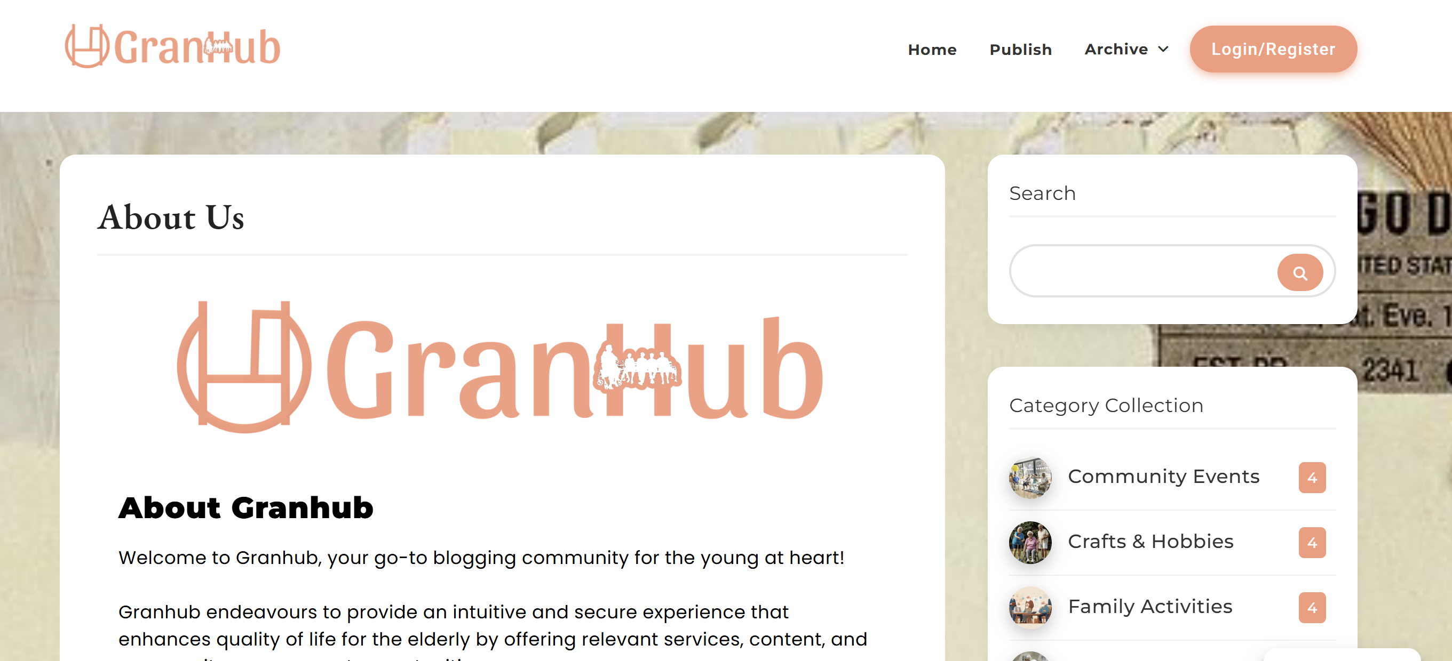
What does
At Granhub, we offer:
– A user-friendly blogging platform tailored for seniors – A supportive community of like-minded individuals – Resources and guides to help our users navigate the digital world – Regular features highlighting inspiring stories from our community members
Our approach is rooted in respect, inclusivity, and the belief that learning and sharing never stop, regardless of age.
www.granhub.co.uk

Slide 4
Benefits for Members
Exclusive resources & activities.
Access to members‑only workshops & events.
Peer community of supportive grandparents.
Discounts & offers from trusted partners.
A sense of belonging & shared purpose.
Join
www.granhub.co.uk

Slide 5
Join
Benefits for Partners
Direct access to engaged grandparents & families.
Co‑branding opportunities in events & content.
Showcase products or services to a relevant audience.
Strengthen CSR through social impact.
Collaborate on content, events, or community projects.
www.granhub.co.uk

Slide 6
Membership & Partnership Models
Membership Tiers:
Free: Access to basic content & community.
Premium: Exclusive workshops, event invitations, discounts.
Patron: Recognition, special perks, and priority access.
Partnership Opportunities:
Content Partners (blogs, workshops).
Event Partners (co‑host, sponsor, venue).
Business Affiliates (offers, discounts).
Strategic Sponsors (branding, CSR collaborations).
www.granhub.co.uk

Slide 7
Join Us Today!
www.granhub.co.uk | info@synergysolution.co.uk

